Slide 1




PREDICTIVE MAINTENANCE OF AIRCRAFT ENGINES
Machine Learning Approaches for Remaining Useful Life Estimation
Presented by:
Dr. Deepika J
Pappuru Manikanta Reddy
Kothaluri Murari
Boyana Rahul

Slide 2
OVERVIEW
Introduction
Model building
Problem statement
Methodology
Implementation
Preprocessing
Results
Comparison
Conclusion
Future scope

Slide 3
INTRODUCTION
Aircraft engines are critical; failure can lead to emergency landings and loss of life due to high temperature, pressure, and stress.
Predictive maintenance uses real-time sensor data to forecast failures, shifting from reactive and preventive approaches.
Machine learning predicts Remaining Useful Life (RUL) by analyzing sensor data, enabling early anomaly detection and reducing downtime.
Predictive maintenance improves efficiency, reduces costs, and enhances safety by preventing critical failures and extending component lifespan.
Notes:
Introduction
Good [morning/afternoon/evening] everyone, Today, I’ll be discussing "Predictive Maintenance of Aircraft Engines: Machine Learning Approaches for Remaining Useful Life Estimation.“
Aircraft engines are critical to flight safety, operating under extreme conditions of high temperature, pressure, and stress. These factors make them prone to wear and potential failures, which can result in emergency landings, costly repairs, or even loss of life.
Traditional maintenance methods like reactive and preventive approaches have limitations. Reactive maintenance addresses issues only after failure, leading to unplanned downtime and higher costs. Preventive maintenance, on the other hand, follows a fixed schedule, which can lead to over-servicing or under-servicing.
Predictive maintenance overcomes these challenges by using real-time sensor data to predict the Remaining Useful Life (RUL) of components. This allows us to detect anomalies early, reducing downtime, preventing critical failures, and improving overall safety.
Our research focuses on leveraging machine learning models to forecast RUL. Machine learning provides a balance between accuracy and computational efficiency, making it suitable for this task. Using NASA’s C-MAPSS dataset, we analyze critical sensor data to develop robust predictive models. Additionally, we’ve integrated the predictive system with a PostgreSQL database for data management and a Flask-based web interface for visualization, making the system both efficient and user-friendly.
With this foundation, let’s move forward to understand our methodology and results in more detail.

Slide 4
Deep neural networks (DNNs) learn complex patterns in historical sensor data to predict RUL.
Existing Methodologies
Recurrent neural networks (RNNs), especially LSTM, capture temporal dependencies for accurate RUL forecasting.
Time-series sensor data is used to predict engine degradation and estimate future RUL.
Feature extraction from sensor data helps deep learning models accurately estimate RUL over time.
Notes:
How to Achieve RUL Prediction Using Deep Learning
Deep learning models like Deep Neural Networks (DNNs) and Recurrent Neural Networks (RNNs), especially LSTMs, are highly effective for predicting the Remaining Useful Life (RUL) of engines.
LSTMs excel at analyzing time-series sensor data, capturing patterns over time to forecast engine degradation. These models use end-to-end learning, automating RUL prediction without requiring extensive manual feature engineering.
By extracting key features from sensor data, deep learning models achieve accurate and efficient predictions, making them ideal for time-sensitive applications like predictive maintenance.

Slide 5
WHY NOT DEEP LEARNING AND WHY MACHINE LEARNING
Challenges of Deep Learning:
WHY Machine Learning:
Requires large datasets for training.
High computational resource demands.
Often considered a "black box" with limited interpretability.
Takes longer to train compared to traditional models.
Prone to overfitting without proper tuning.
Requires fewer computational resources than deep learning.
Faster training with smaller datasets.
Offers better model interpretability and transparency.
Easier to implement and deploy in practical applications.
Can achieve competitive accuracy with lower complexity.
Notes:
WHY NOT DEEP LEARNING AND WHY MACHINE LEARNING While deep learning is powerful, it comes with challenges: it requires large datasets, high computational resources, and is often a "black box" with limited interpretability. Training is also time-consuming and risks overfitting without careful tuning.
Machine learning, on the other hand, is more practical. It needs fewer resources, trains faster on smaller datasets, and provides better interpretability and transparency. It’s easier to deploy in real-world applications and can still achieve competitive accuracy with lower complexity.
This makes machine learning a more efficient and accessible choice for RUL prediction in our study.

Slide 6
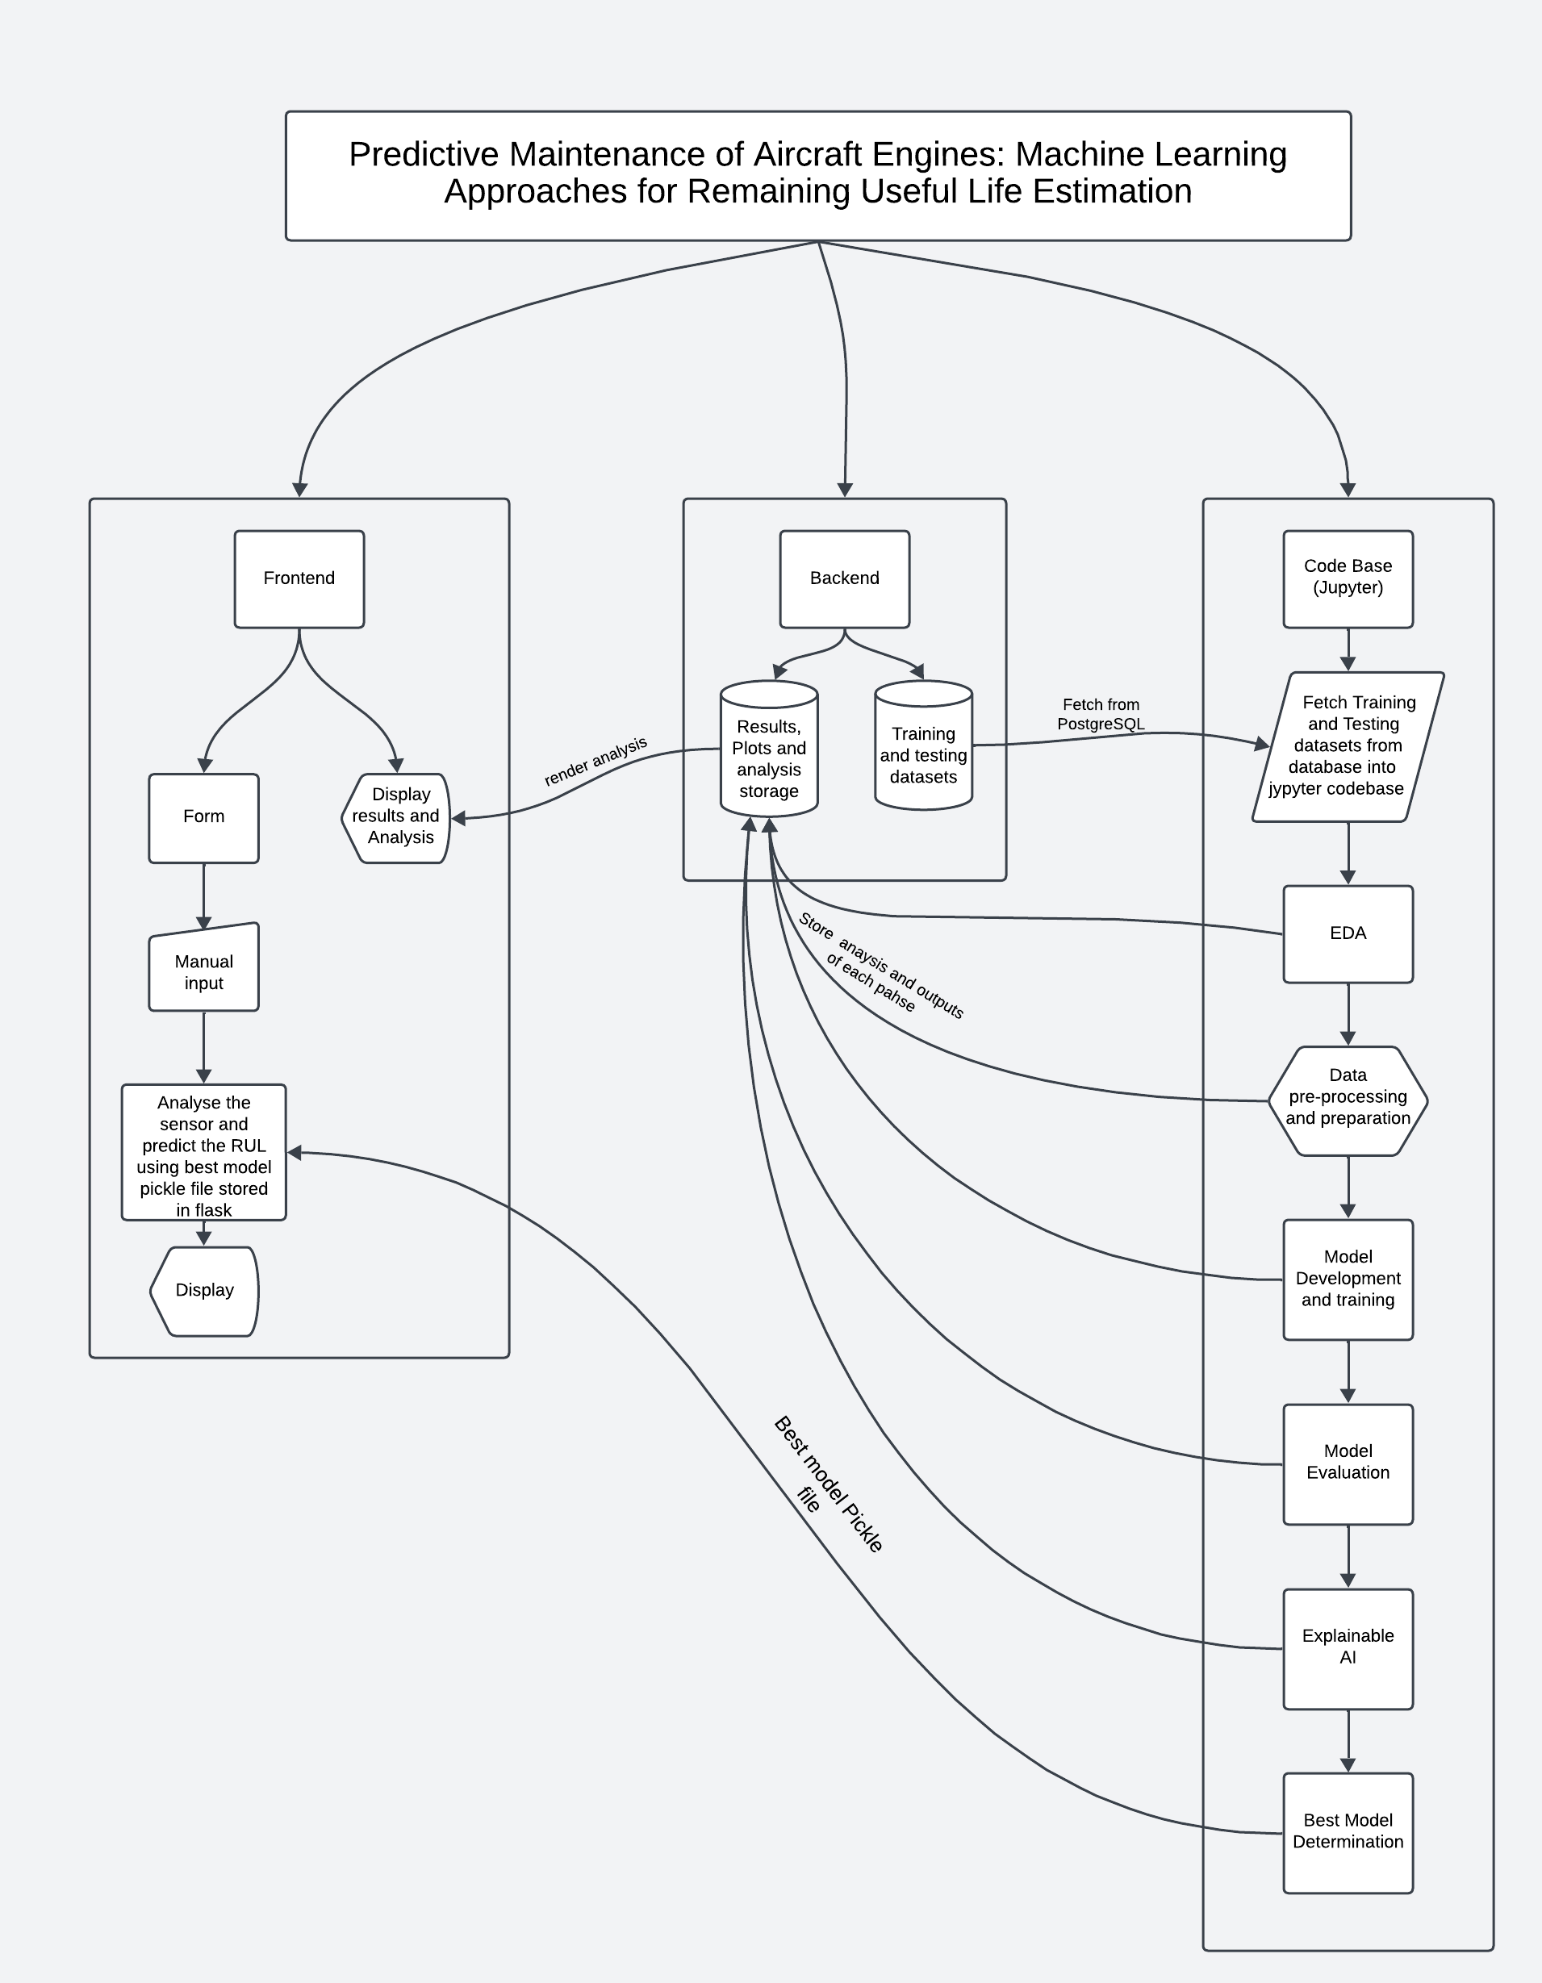
METHODOLOGY
Frontend: Flask-based interface for interactive RUL predictions.
Backend: PostgreSQL for managing sensor data and results.
ML Pipeline: Data preprocessing, feature selection, model training, and evaluation​
Notes:
Methodology
Our methodology integrates several key components to ensure accurate and efficient RUL predictions.
On the frontend, we’ve developed a Flask-based interface to allow users to interactively input data and visualize RUL predictions. The backend utilizes PostgreSQL to manage sensor data and store prediction results efficiently.
The core is our machine learning pipeline, which includes data preprocessing to clean and prepare the data, feature selection to identify critical parameters, and model training followed by evaluation to ensure high prediction accuracy.
This structured approach ensures smooth operation, reliable results, and user-friendly interaction.

Slide 7
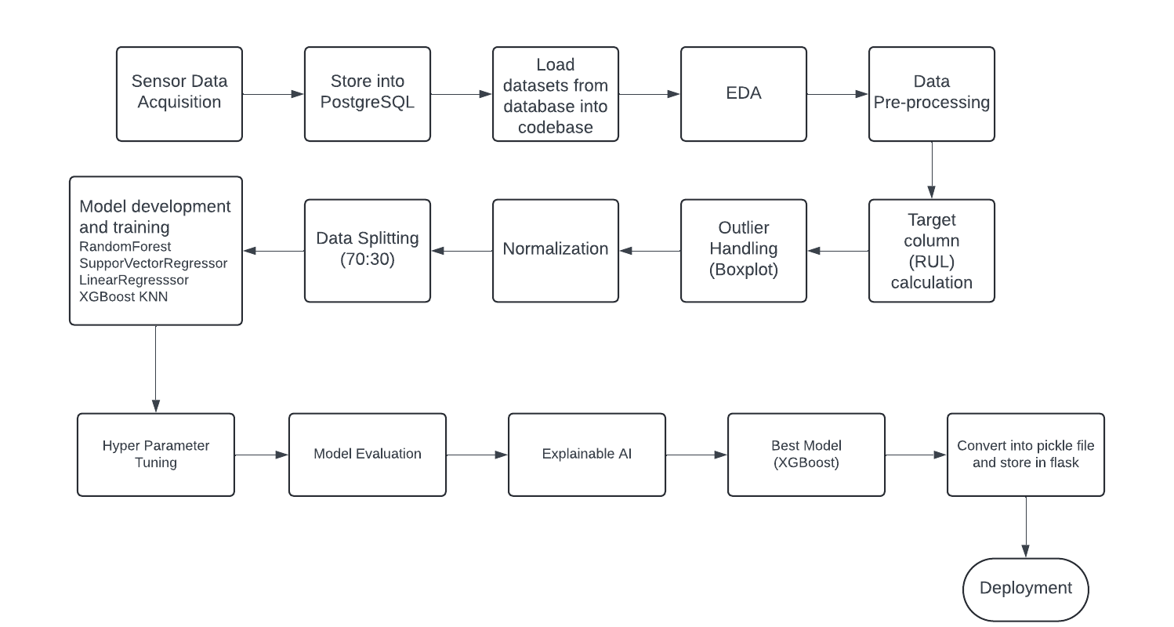
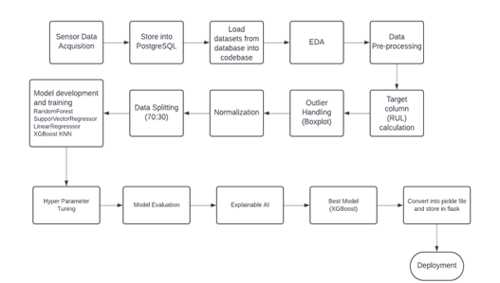
IMPLEMENTATION
Notes:
It begins with sensor data acquisition, storing data in PostgreSQL, and loading it for Exploratory Data Analysis (EDA) and preprocessing. Key steps include handling outliers, normalization, target column calculation, and data splitting. Models such as Random Forest, SVM, and XGBoost are trained, evaluated, and tuned, with XGBoost selected as the best model. The model is then serialized for deployment using Flask.

Slide 8
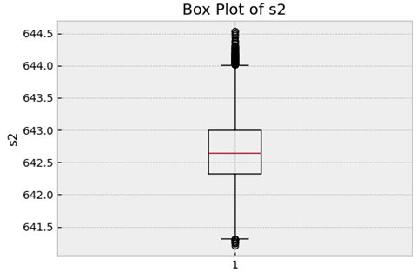
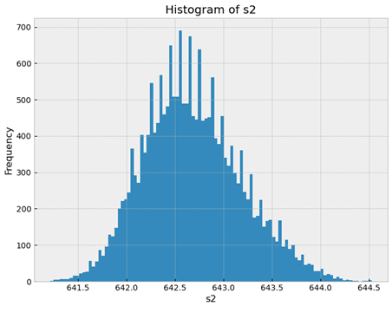
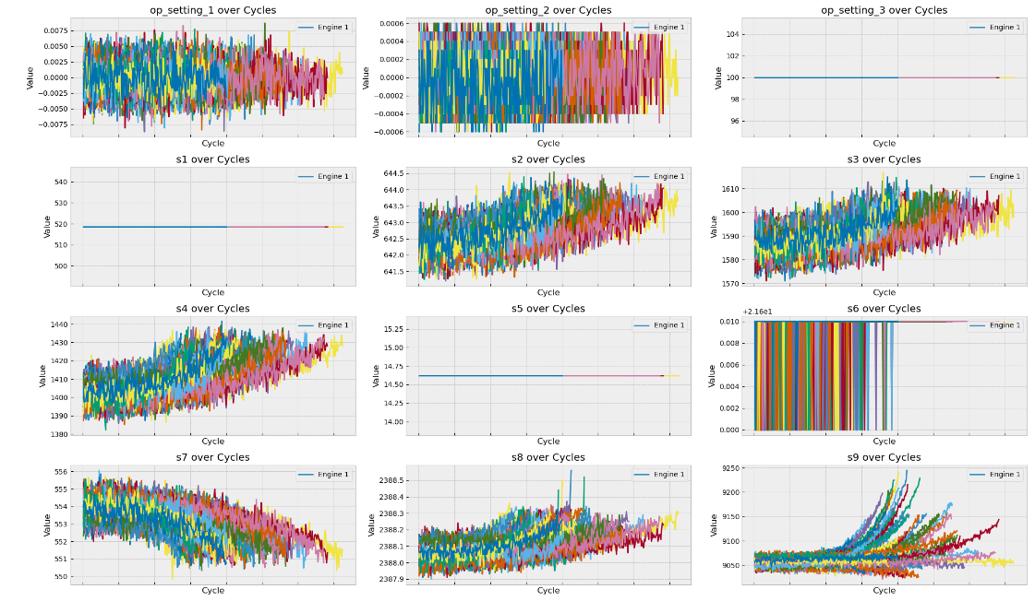
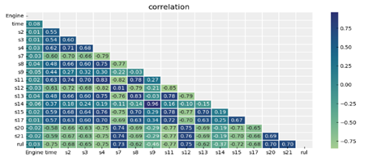
PRE-PROCESSING
Boxplots for outlier detection
Histograms to examine data distribution
Feature Trend Analysis
Correlation matrices
Notes:
The preprocessing phase plays a vital role in preparing the data for modeling. It includes essential steps such as Exploratory Data Analysis (EDA), outlier detection, and normalization. Here's a summary of the key steps:
Exploratory Data Analysis (EDA):
Engine Count: Determined the number of unique engines, helping identify trends and set the target column.
Identified Features’ Trend: Analyzed sensor data to find relevant features for RUL prediction, removing those with low variability.
Histograms and Boxplots: Employed to check the distribution of data and detect outliers in sensor readings.
Correlation Matrix: Used to identify highly correlated features and remove those to prevent multicollinearity.
Data Normalization and Scaling:
Min-Max Scaling was applied initially, but the StandardScaler yielded better results, ensuring consistency across datasets.
Target Column Construction:
The Remaining Useful Life (RUL) was calculated based on operational cycles and capped at 130, improving model performance.
Data Splitting:
The data was split into a 70:30 ratio for training and testing purposes.
Boxplots are used to detect and visualize outliers in the data. Outliers are any data points that lie beyond the whiskers (1.5 times the interquartile range, IQR). These are often anomalies or extreme values that can distort machine learning models' predictions. Histograms display the distribution of values in the dataset. These visualizations help in understanding the spread, central tendency, and shape of the data, allowing for decisions on scaling, normalization, and outlier removal. A correlation matrix shows how strongly different features are related. Highly correlated features (multicollinearity) can distort the model's learning process, so identifying and removing or combining them can improve model performance.

Slide 9
PRE-PROCESSING
Data Normalization and Scaling:
Min-Max Scaling was applied initially, but the StandardScaler yielded better results, ensuring consistency across datasets.
Target Column Construction:
The Remaining Useful Life (RUL) was calculated based on operational cycles and capped at 130, improving model performance.
Data Splitting:
The data was split into a 70:30 ratio for training and testing purposes.
Notes:
Data Normalization and Scaling:
Min-Max Scaling was applied initially, but the StandardScaler yielded better results, ensuring consistency across datasets.
Target Column Construction:
The Remaining Useful Life (RUL) was calculated based on operational cycles and capped at 130, improving model performance.
Data Splitting:
The data was split into a 70:30 ratio for training and testing purposes.

Slide 10
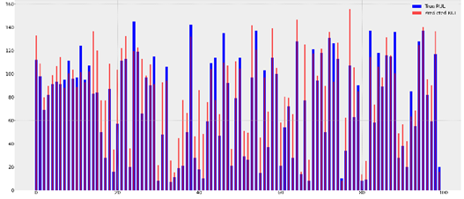
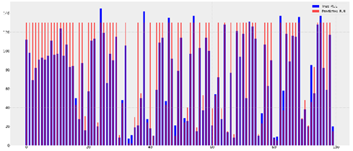
Model Building and Training
LINEAR REGRESSION
KNN
Simple baseline model for interpretability​
Metrics:
Training RMSE: 22.62, R² = 0.73
Testing RMSE: 29.07, R² = 0.51
Effective for local pattern-based predictions but less accurate overall.
Metrics:
Training RMSE: 29.16, R² = 0.55
Testing RMSE: 30.73, R² = 0.45
Notes:
MSE for Error Magnitude: Shows the absolute size of the prediction error, which is crucial for applications where specific error values have real-world significance.
R² for Model Fit: Indicates how well the model captures the variability in the data, useful for assessing overall model performance and comparing models.
Model Building and Training
Linear Regression (LR)
The linear regression model is effective for understanding basic trends in the data, though it may struggle with more complex patterns. The RMSE values show that the model performs reasonably well during training but has some degree of error during testing.
Metrics:
Training RMSE: 22.62
Testing RMSE: 29.07
2. K-Nearest Neighbors (KNN)
While KNN captures local patterns well, it does not perform as well overall, particularly for complex or high-dimensional data, as indicated by the higher RMSE values for both training and testing.
Metrics:
Training RMSE: 29.16
Testing RMSE: 30.73
Evaluation Metrics:
RMSE (Root Mean Square Error): Measures prediction error, with lower values indicating better model performance.
R² (Coefficient of Determination): Indicates how well the model fits the data, with values closer to 1 being ideal.

Slide 11
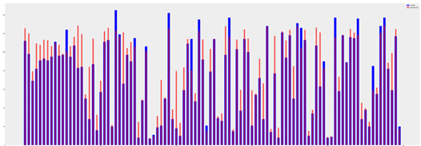
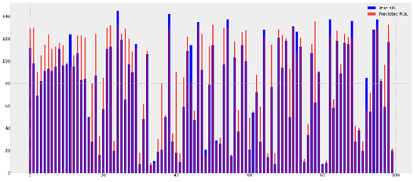
RANDOM FOREST REGRESSOR
SUPPORT VECTOR REGRESSOR
Captures non-linear relationships but risks overfitting.
Metrics:
Training RMSE: 15.79, R² = 0.86
Testing RMSE: 28.15, R² = 0.54
Handles high-dimensional data effectively with consistent performance​
Metrics:
Training RMSE: 19.76, R² = 0.79
Testing RMSE: 23.70, R² = 0.67
Notes:
Random Forest: Excellent for capturing both linear and non-linear relationships in complex datasets. It provides feature relevance metrics to highlight sensors critical to engine deterioration.
Metrics:
Training RMSE: 15.79
Testing RMSE: 28.15
Support Vector Regressor (SVR): Well-suited for small to medium-sized datasets with high dimensionality. SVR uses kernel functions to model non-linear relationships and is particularly useful when linear models are ineffective.
Metrics:
Training RMSE: 19.76
Testing RMSE: 23.70

Slide 12
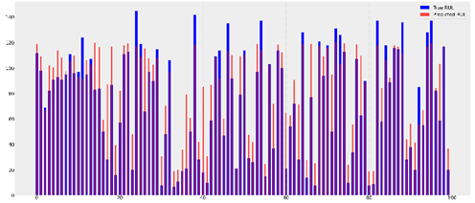
Emerged as the best-performing model with robust results
XGBoost is efficient, accurate, interpretable, scalable, and robust, making it ideal for real-time predictive maintenance in aviation.
XGBOOST(BEST ONE)
Metrics:
Training RMSE: 20.58, R² = 0.77
Testing RMSE: 23.80, R² = 0.67
The training are testing RMSE are closely aligned, and it generalizes better than other models, making it the best choice.
Notes:
After training, the models were assessed for overfitting and underfitting by comparing RMSE and R² scores for both training and validation datasets. Ideally, these scores should be close to each other for a well-balanced model.
Best Model: XGBoost Regressor was selected as the best model due to its strong performance (RMSE < 25 and R² between 65-70). These metrics are typically associated with deep learning models and indicate a good fit for predicting RUL.
Metrics:
Training RMSE: 20.58
Testing RMSE: 23.80
The training are testing RMSE are closely aligned, and it generalizes better than other models, making it the best choice.
Model Serialization: The selected XGBoost model was serialized into a pickle file and integrated into the Flask application to enable dynamic RUL predictions based on user input.

Slide 13
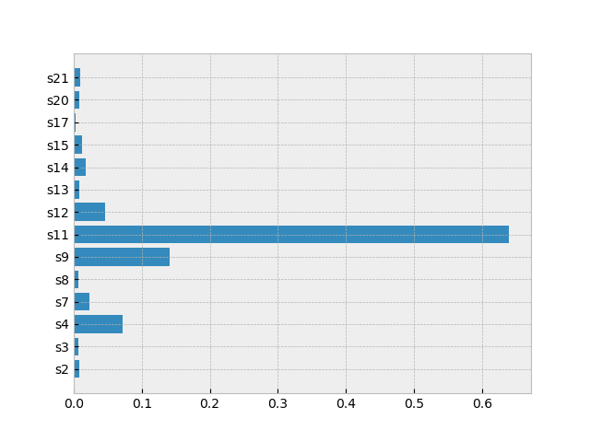
Explainable AI (XAI)
XAI helps in understanding and interpreting the decisions made by machine learning models, making it clear why these features contribute significantly to predicting the Remaining Useful Life (RUL).
This transparency enhances model reliability and trust.
The following features were identified as most influential:
's4', 's7’, ‘s9', 's11', 's12'.
Feature Contribution of each feature for prediction
Notes:
The most influential features identified using Explainable AI (XAI) techniques are 's4', 's7', 's9', 's11', and 's12'. XAI helps in understanding and interpreting the decisions made by machine learning models, making it clear why these features contribute significantly to predicting the Remaining Useful Life (RUL). This transparency enhances model reliability and trust.

Slide 14
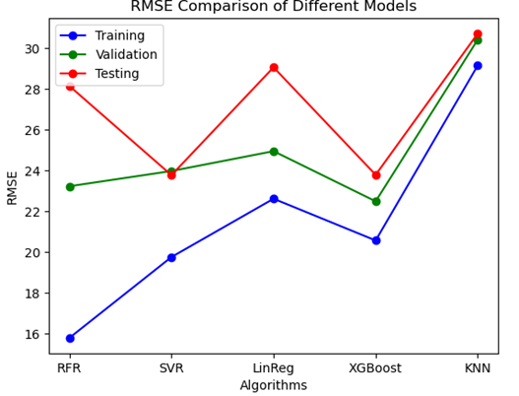
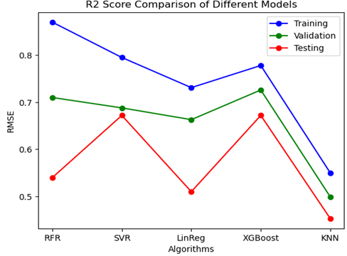
RESULT TABLE AND COMPARISON
Model | Training RMSE | Training R² | Testing RMSE | Testing R²
Random Forest | 15.79 | 0.86 | 28.15 | 0.54
SVR | 19.76 | 0.79 | 23.7 | 0.67
Linear Regression | 22.62 | 0.73 | 29.07 | 0.51
XGBoost | 20.58 | 0.77 | 23.8 | 0.67
KNN | 29.16 | 0.55 | 30.73 | 0.45
RMSE COMPARISON FOR DIFFERENT MODELS
R² SCORE COMPARISON FOR DIFFERENT MODELS
TABLE 1:RESULTS OF THE PREDICTION PERFORMANCE FOR EACH MODEL
Notes:
Observations and Insights:
The XGBoost Regressor is the top performer for predicting Remaining Useful Life (RUL), with a training RMSE of 20.58 and an R² score of 0.78, showing strong accuracy without overfitting. Its test set performance (RMSE of 23.80) is consistent with the training results, making it reliable. Compared to models like Random Forest and Support Vector Regressor, XGBoost delivers better generalization, with fewer signs of overfitting and stronger feature handling. This makes XGBoost the ideal choice for RUL prediction in predictive maintenance.

Slide 15
Comparison of Results with other works
Reference/ Author name | Model | RMSE
This paper | XGBoost | RMSE = 23.8
Ellefsen et al., 2018 | Semi Supervised based architecture | RMSE = 26
Mathew et al., 2017 | Random Forest | RMSE = 24.9
FernandoSánchez Lasheras and associates | Hybrid model combining Support Vector Machines (SVM) and the Autoregressive Integrated Moving Average (ARIMA) | RMSE = 39.7
Kang et al., 2021 | ANN | RMSE = 25.8
Notes:
Comparative Study:
The XGBoost model, with an RMSE of 23.8, outperforms several other models in existing literature. For example, the Semi-Supervised Architecture by Ellefsen et al. (2018) has an RMSE of 26, and Random Forest by Mathew et al. (2017) performs with an RMSE of 24.9. The Hybrid SVM-ARIMA Model by Fernando Sánchez Lasheras (RMSE = 39.7) and ANN by Kang et al. (2021) with RMSE of 25.8 also fall short compared to XGBoost. This highlights the superior accuracy and efficiency of XGBoost in predicting RUL compared to both traditional and hybrid models.

Slide 16
CONCLUSION
Machine learning models like XGBoost and SVRprovide accurate RUL predictions with low complexity, outperforming deep learning in computational efficiency.
XGBoost delivers high performance (low RMSE, high R²) while maintaining explainability through XAI techniques, ensuring transparency and trust.
The system integrates PostgreSQL, Flask, and machine learning, offering efficient data storage, real-time interactions, and predictive modeling.
Machine learning requires fewer resources, reducing downtime, optimizing maintenance, and ensuring reliability, making it scalable for future applications in aviation and beyond.
Notes:
This research demonstrates the advantages of machine learning over complex deep learning models in predictive maintenance. By using regression techniques like XGBoost, Random Forest, and Support Vector Regressor, the system achieved accurate Remaining Useful Life (RUL) predictions with low RMSE and high R², without the resource demands of deep learning models like LSTM. The system's explainability, through XAI techniques, enhances transparency, allowing stakeholders to understand the factors influencing predictions, making it ideal for industries like aviation where safety is critical. This approach offers comparable accuracy to deep learning but with lower resource requirements, making it suitable for real-time predictive maintenance in aviation and beyond.

Slide 17
FUTURE SCOPE
Incorporate advanced Explainable AI techniques for transparent and interpretable RUL predictions.
Experiment with RUL threshold adjustment to improve alignment with real-world engine degradation and accuracy.
Use advanced outlier detection algorithms to remove noisy data and enhance model stability for time-series data.
Combine ML and DL approaches in hybrid models to improve forecast accuracy for real-time applications and larger datasets.
Notes:
As we look forward to further developing our system, there are several areas where we can make impactful improvements.
We aim to incorporate more advanced Explainable AI (XAI) techniques for better transparency in RUL predictions. Experimenting with different RUL threshold values could improve accuracy by aligning better with real-world engine degradation. Using advanced outlier detection algorithms will help remove noisy data and enhance model stability, especially for time-series data. Finally, combining Machine Learning (ML) with Deep Learning (DL) in hybrid models could boost accuracy, particularly for real-time applications and larger datasets. These enhancements will improve the system’s reliability and effectiveness.

